Slide 1

JC2001 Introduction to Software Engineering
Lecture 3: Project management
Dr Huang Yongchao yongchao.huang@abdn.ac.uk
Dr Junfeng Gao junfeng.gao@abdn.ac.uk
Notes:
…
This course is very important, especially if you want to work in the software development industry and IT companies, for example, Tiktok, Baidu, Google, Amazon, and so on.
In this course, we will NOT introduce any programming language. However, we will introduce the technology that how to architect your software and manage your software development process, human resource, and risks.
So, this course will roughly let you know how an IT company works, that is, how to develop software by a team.
Or, if you want to establish your own IT company, we will let you know how to manage your staff and your projects.

Slide 2
Outline
Project management (Chapter 22)
Reference: Ian Sommerville, Software Engineering, 10th edition, Pearson, 2015.

Slide 3
Why is project management important?
Project management helps businesses manage change.
Brings clarity to the chaos of project activities.
Synchronise team effort.
Maintain control over project scope, budget and timelines.

Slide 4
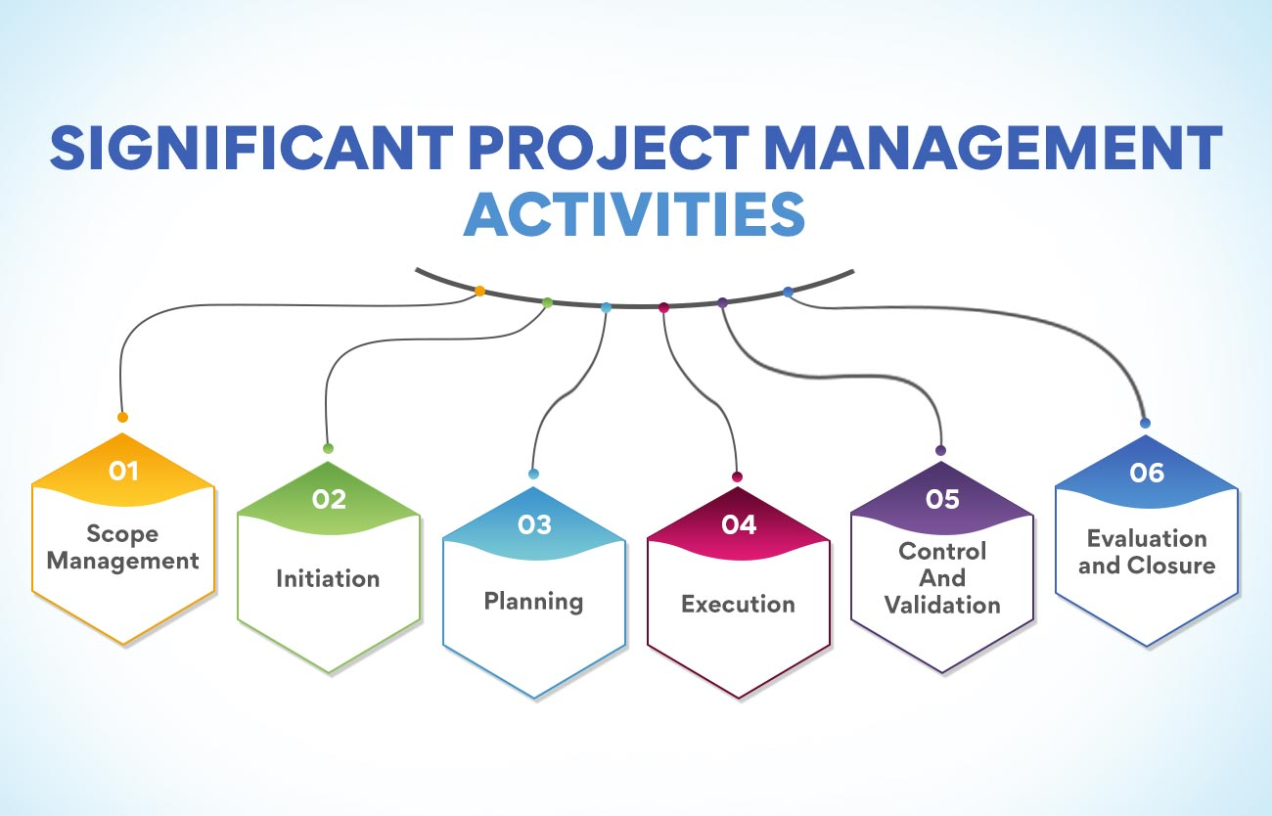

Slide 5
Project management activities
Project planning.
Task management.
Resource allocation.
Time tracking.
Collaboration tools.
Risk management.
Reporting and analytics.
Budget management.

Slide 6

Famous failed projects – New coke
Coca cola unveiled new coke in 1985.
People preferred it over the traditional version.
But people did not buy it as expected. Why?
Product loyalty.
Old fashion habits.
New coke cost Coca cola a loss of $30 million.

Slide 7

Famous failed projects – Arch deluxe burger
McDonalds designed a new burger.
They spent $150 million in advertising.
But people were not interested!

Slide 8



Mock quiz
Did McDonalds know what their customers wanted? Yes or no? Explain your answer.
Arch deluxe burger
Cheese burger

Slide 9
Know what your customers want
The New coke and Arch deluxe burger case studies showed that it is important to know what your customers want.
In the New coke case, Coca cola did not understand that their customers are loyal to their original coca cola product. They also tried to change their customers habit.
In the McDonalds case, they failed to obtain an accurate picture of what their customers wanted. ** Fast food **

Slide 10
Definition of project management
What is software project management (SPM)?
SPM is an essential part of software engineering.
Projects need to be managed because professional software engineering is always subject to organisational budget and schedule constraints.
The job of the project manager (PM) is to ensure that the software project meets and overcomes these constraints as well as delivering high-quality software.
Good management cannot guarantee project success.
Bad management usually results in project failure, e.g., software may be delivered late, cost more than originally estimated, or fail to meet the expectations of customers.

Slide 11
Goals of project management
The important goals are:
To deliver the software to the customer at the agreed time.
To keep overall costs within budget.
To deliver software that meets the customer’s expectations.
To maintain a coherent and well-functioning development team.
These goals are not unique to software engineering (SE), but are the goals of all engineering projects. However, SE projects are different from other types of engineering projects in a number of ways.

Slide 12
SE projects vs. engineering projects
SE projects differ from other types of engineering projects in the following ways:
The product is intangible.
A manager of a building construction project can see the building being developed. If the schedule slips, the effect on the construction of the building is visible. However, software is intangible, it cannot be seen or touched when it is being developed.
The PM relies on their staff to produce evidence that they can use to review the progress of the work.
Large software projects are often “one-off” or bespoke projects.
Every large software development project is unique because every environment where software is developed is, in some ways, different from all others.
Even managers with previous experience may find it difficult to anticipate problems. Furthermore, rapid technology changes in computers and communications can make experience obsolete.
Lessons learned from past projects may not be transferable to new projects.

Slide 13
SE projects vs. engineering projects
SE projects differ from other types of engineering projects in the following ways (cont’d):
Software processes are variable and organisation-specific.
The engineering process for some types of system, such as buildings and railways, is well-understood. However, different companies use quite different software development processes.
It is a challenge to predict, with high confidence, when a particular software process is likely to lead to development problems. This is especially true when the software project is part of a wider systems engineering project when the new software is being developed.
Because of these issues, it is not surprising that some software projects are late, over budget, and behind schedule.

Slide 14
Factors that affect SPM
The job of a PM varies depending on the organisation and the software being developed. Important factors that affect how software projects are managed are:
Company size:
Small companies can operate with informal management and team communications, and do not need formal policies and management structure. In larger companies, management hierarchies, formal reporting and budgeting, and approval processes must be followed.
Software customers:
If the customer is an internal customer, then customer communication can be informal and there is no need to fit in with the customer’s way of working.
If custom software is being developed for an external customer, agreement has to be reached on more formal communication channels.

Slide 15
Factors that affect SPM
Important factors that affect how software projects are managed are (cont’d):
Software size:
Small systems can be developed by a small team, which can get together in the same room to discuss progress and other management issues. Large systems usually need multiple development teams that may be geographically distributed and in different companies. The PM has to coordinate the activities of these teams and arrange for them to communicate with each other.
Software type:
If the software being developed is a consumer product, formal records of project management decisions are unnecessary. On the other hand, if a safety-critical system, e.g., flight control, coolant distribution system for a nuclear power plant is being developed, all project management decisions should be recorded and justified as these may affect the safety of the system.

Slide 16
Factors that affect SPM
Important factors that affect how software projects are managed are (cont’d):
Organisational culture:
Some organisations have a culture that is based on supporting and encouraging individuals, while others are group focused.
Large organisations are often bureaucratic. Some organisations have a culture of risk taking, whereas others are risk averse.
Software development process:
Agile processes typically try to operate with “lightweight” management.
More formal processes require management monitoring to ensure that the development team is following the defined process.

Slide 17
Project management activities
The following project management activities are common to all organisations:
Project planning:
PMs are responsible for planning, estimating, and scheduling project development and assigning people to tasks. PMs supervise the work to ensure that it is carried out to the required standards.
Risk management:
PMs have to assess the risks that may affect a project, monitor these risks, and take action when problems arise.
People management:
PMs are responsible for managing a team of people. They have to choose people for their team and establish ways of working that lead to effective team performance.

Slide 18
Project management activities
The following project management activities are common to all organisations (cont’d):
Reporting:
PMs are responsible for reporting on the progress of a project to customers and to managers of the company developing the software. The PM has to be able to communicate at a range of levels, from detailed technical information to management summaries. They have to write concise, coherent documents that abstract important information from detailed project reports, and present this information during progress reviews.
Proposal writing:
The first stage of a software project may involve writing a proposal to win a contract to carry out an item of work. The proposal usually describes the objectives of the project and how it will be carried out. It also includes cost and schedule estimates, and a justification of why the contract should be awarded to a particular organisation or team.

Slide 19
Mock quiz
You are leading a team of 2 software developers in implementing a new software product. The deadline for releasing an alpha-version of the software is in 2 weeks time. One developer has called in and ask if they could take 1 week emergency leave. 75% of the software’s functions are complete. Would you grant the developer the leave they requested? If yes, what are the consequences? If no, what are the consequences?
Alpha version is an early version of a program or application, typically unstable, but useful to show what the product will do.

Slide 20
Managing people
The people working in a software organisation are its greatest assets. It is expensive to recruit and retain good people, and it is up to software managers to ensure that the engineers working on a project are as productive as possible.
Successful companies achieve productivity when people are respected by the organisation and are assigned responsibilities that reflect their skills and experience.
It is important that software PMs understand the technical issues that influence the work of software development. As a PM, it is important that you are aware of potential problems of people management and try to develop people management skills.

Slide 21
Managing people
There are four important factors that influence the relationship between a manager and the people that the manager manages:
Consistency:
All the people in a project team should be treated in a comparable way. No one expects all rewards to be identical, but people should not feel that their contribution to the organisation is undervalued.
Respect:
Different people have different skills, and managers should respect these differences. All members of the team should be given an opportunity to make a contribution. In some cases, you will find that people simply don’t fit into a team and they cannot continue, but it is important not to jump to conclusions about them at an early stage of the project.

Slide 22
Managing people
There are four important factors that influence the relationship between a manager and the people that the manager manages (cont’d):
Inclusion:
People contribute effectively when they feel that others listen to them and take into account of their proposals. It is important to develop a working environment where all views, even those of the least experienced staff, are considered.
Honesty:
As a manager, you should always be honest about what is going on well and what is going badly in the team. You should be honest about your level of technical knowledge and be willing to defer to staff with more knowledge when necessary.

Slide 23
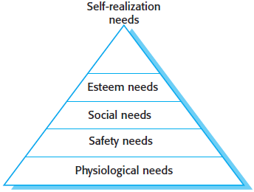
Motivating people
As a PM, you need to motivate the people who work with you so that they will contribute to the best of their abilities. In practice, motivation means organising work and its environment to encourage people to work effectively as possible.
To provide this encouragement, we will try to understand a little about what motivates people. Maslow’s human needs hierarchy arranges these needs in a series of levels.
In a software development project, ensuring that people’s social, esteem and self-realisation needs are satisfied is most important from a management point of view.

Slide 24
Motivating people
To satisfy social needs, you need to give people time to meet their colleagues and provide places for them to meet. Companies such as Google and Microsoft provide social space in their offices for people to meet. This is easy when all of the members of a development team work in the same place, but increasingly, team members are not located in the same building or even the same town or estate. They may work for different organisations or from home most of the time.
Social networking systems and teleconferencing can be used for remote communications, but these systems will only be effective when people already know each other. Direct interaction early on in a project brings people together in a social group and accept the goals and priorities of that group.

Slide 25
Motivating people
To satisfy esteem needs, you need to show people that they are valued by the organisation. Public recognition of achievements is a simple and effective way of doing this. People must also feel that they are paid at a level that reflects their skills and experience.
To satisfy self-realisation needs, you need to give people responsibility for their work, assign them demanding (but not impossible) tasks, and provide opportunities for training and development where people can enhance their skills. Training is an important motivating influence as people like to gain new knowledge and learn new skills.

Slide 26
Psychological personality types
Bass and Dunteman (1963) identified three psychological personality types that influence the motivation of professional workers:
Task-oriented people:
They are motivated by the work they do. In SE, these are people who are motivated by the intellectual challenge of software development.
Self-oriented people:
They are primarily motivated by personal success and recognition. They are interested in SE as a means of achieving their own goals. They often have longer-term goals, such as career progression, that motivate them, and they wish to be successful in their work to help realise these goals.
Interaction-oriented people:
They are motivated by the presence and actions of colleagues.

Slide 27
Psychological personality types
Interaction-oriented personalities usually like to work as part of a group.
Task-oriented and self-oriented people usually prefer to work as individuals.
Each individual’s motivation is made up of elements of each personality type, but one type of motivation is usually dominant at any one time. However, individuals can change.
For example, technical people who feel they are not properly rewarded can become self-oriented and put personal interests before technical concerns.
If a group works particularly well, self-oriented people can become more interaction-oriented.

Slide 28
Teamwork
Most professional software is developed by project teams that range in size from two to several hundred people. However, it is impossible for everyone in a large group to work together on a single problem. Thus, large teams are usually split into a number of smaller groups. Each group is responsible for developing part of the overall system.
The best size for a software engineering group is 4 to 6 members, and they should never have more than 12 members. When groups are small, communication overheads are reduced. Everyone knows everyone else, and the whole group can get around a table for a meeting to discuss the project and the software that they are developing.

Slide 29
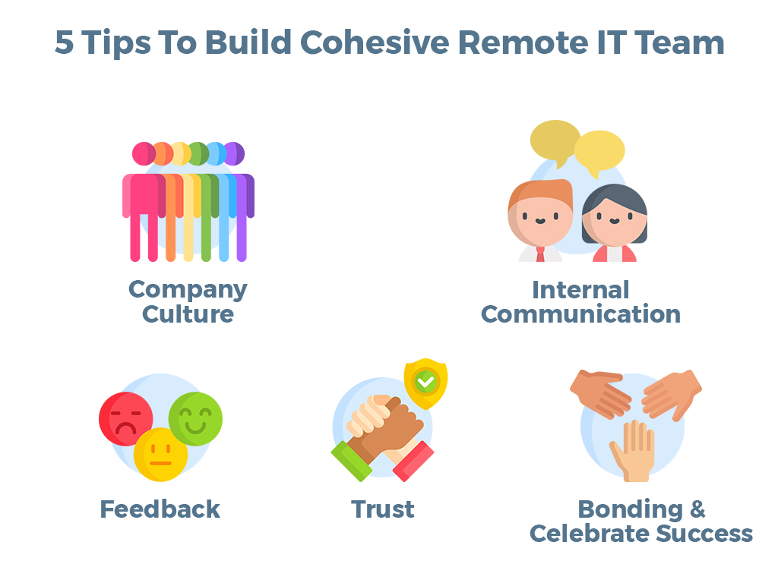

Teamwork
Putting together a group is an important management task:
There is a need to find the right balance of technical skills, experience, and personalities.
There is also a need to recruit the ``right’’ members in order to create a cohesive group.

Slide 30
Teamwork
The benefits of creating a cohesive group are:
The group can establish its own quality standards.
Individuals learn from and support each other.
Knowledge is shared.
Refactoring and continual improvement is encouraged.
Good managers will try to establish a sense of group identity. Some managers like explicit group-building activities such as sports, games, and social events. An effective way of promoting cohesion is to be inclusive, and make information freely available to everyone in the group.

Slide 31
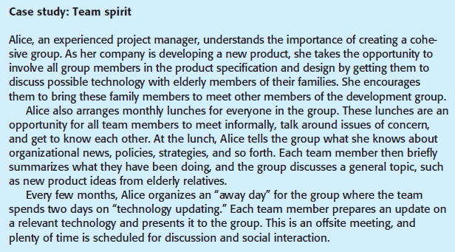
Teamwork

Slide 32
Teamwork
Three factors that have the biggest effect on team working are:
The people in the group. You need a mix of people in a project group as software development involves diverse activities such as negotiating with clients, programming, testing and documentation.
The way the group is organised. A group should be organised so that individuals can contribute to the best of their abilities and tasks can be completed as expected.
Technical and managerial communications. Good communications between group members, and between the software engineering and other project stakeholders, is essential.

Slide 33
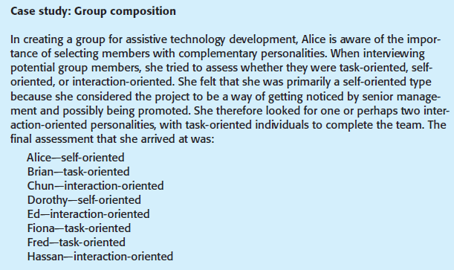
Selecting group members

Slide 34
Group organisation
The way a group is organised affects the group’s decisions, the ways information is exchanged, and the interactions between the development group and external project stakeholders. Important organisational questions for PMs include:
Should the PM be the technical leader of the group?
Who will be involved in making critical technical decisions?
How will interactions with external stakeholders and senior company management be handled?
How can groups integrate people who are not co-located?
How can knowledge be shared across the group?

Slide 35
Group organisation
Small programming groups are usually organised in an informal way.
The group leader gets involved in the software development with the other group members.
In an informal group, the group as a whole discusses the work to be carried out, and tasks are allocated according to ability and experience.
In hierarchical groups, the group leader is at the top of the hierarchy.
They have more formal authority than the group members and so can direct their work.
There is a clear organisational structure, and decisions are made towards the top of the hierarchy and implemented by people lower down.

Slide 36
Group communications
The effectiveness and efficiency of communications are influenced by:
Group size. As a group gets bigger, it gets harder for members to communicate effectively. The number of one-way communication links is n * (n - 1) where n is the group size. In a group of 8 members, there are 56 possible communication pathways. This means that it is quite possible that some people will rarely communicate with each other.
Group structure. People in informally structured groups communicate more effectively than people in groups with a formal, hierarchical structure. In hierarchical groups, communications tend to flow up and down the hierarchy. People at the same level may not talk to each other.
Group composition. People with the same personality types may clash, and, as a result, communications can be inhibited. Therefore, it is important to include people with different personality types so that they complement one another.

Slide 37
Group communications
The effectiveness and efficiency of communications are influenced by (cont’d):
The physical work environment. The organisation of the workplace is a major factor in facilitating or inhibiting communications. While some companies use standard open plan offices for their staff, others invest in providing a workspace that includes a mixture of private and group working areas.
The available communication channels. Communications can take place via email, face-to-face, telephone and social networking. As project teams become increasingly distributed, with team members working remotely, there is a need to make use of interaction technologies, such as conferencing systems, to facilitate group communications.

Slide 38
Summary
We described the list of project management activities.
We discussed the issues of managing and motivating people.
We discussed the importance of teamwork and group communication.

